Slide 1

Introduction to Engineering Drawing

Slide 2
Introduction
Drawing is the way of expressing ideas and thoughts with the help of pictures.
It is essential for all branches of engineering.
Engineering Drawing is the Universal language of all engineer .
Basically it is the Graphic language from which a trained person can visualize and understand the object.

Slide 3
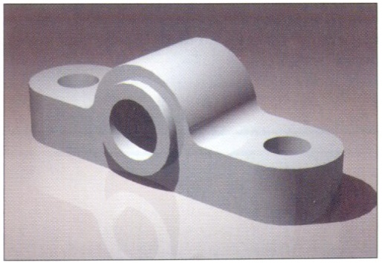
Effectiveness of Graphics Language
1. Try to write a description of
this object.
2. Test your written description
by having someone attempt to make a sketch from your
description.
You can easily understand that …
The word languages are inadequate for describing the size, shape and features completely as well as concisely.

Slide 4
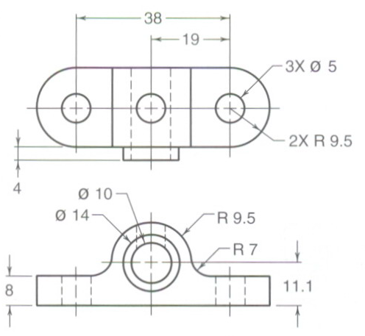
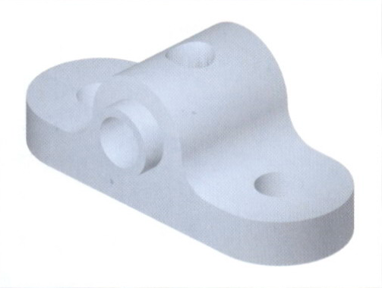
Elements of Engineering Drawing
Engineering drawing are made up of graphics language
and word language.
Graphics
language
Describe a shape (mainly).
Word
language
Describe size, location and specification of the object.

Slide 5
Composition of Graphic Language
Graphic language in “engineering application” use
lines to represent the surfaces, edges and contours of objects.
The language is known as “drawing” or “drafting” .
A drawing can be done using freehand, instruments or computer methods.

Slide 6
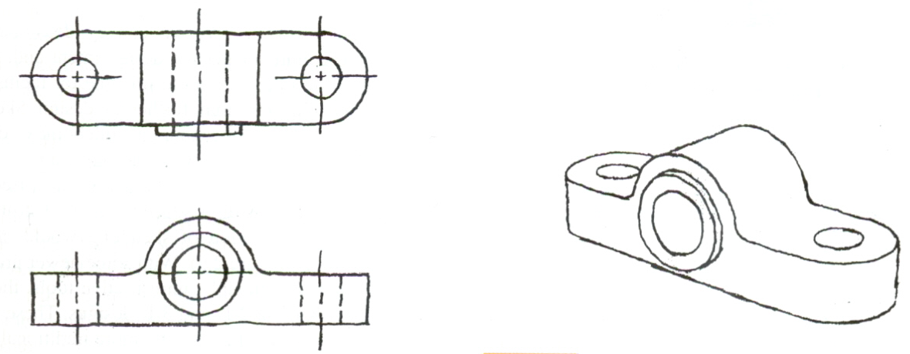
Freehand drawing
The lines are sketched without using instruments other than pencils and erasers.
Example

Slide 7
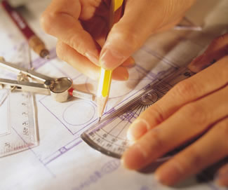
Instrument drawing
Instruments are used to draw straight lines, circles, and curves concisely and accurately. Thus, the drawings are usually made to scale.
Example

Slide 8


Computer drawing
The drawings are usually made by commercial software such as AutoCAD, solid works etc.
Example

Slide 9
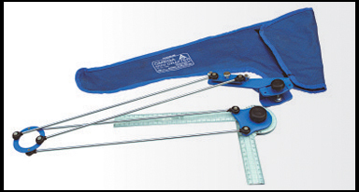
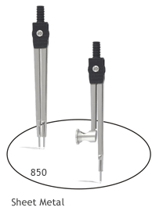
Drawing instruments:-
Drawing board
Drawing Sheet (paper)
Engineering mini Drafter
Compass
Drawing pencils (HB & 2H)
Eraser
Sharpener
Protractor
Drawing clips (4 No’s)
Cleaning Cloth (Handkerchief)

Slide 10
Drawing Sheet
Trimmed paper of
a size A0 ~ A4.
A4
A3
Standard sheet size (ISO)
A4 210 x 297
A3 297 x 420
A2 420 x 594
A1 594 x 841
A0 841 x 1189
A2
A1
(Dimensions in millimeters)
A0

Slide 11

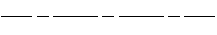

Type of Lines
Type of line | Representation | Description | Grade of Pencil
Outer Line |  | Thick Line | HB
Dimension Line |  | Thin line | HB & 2H
Centre Line |  | Thin line | 2H
Hidden Line |  | Thin line | 2H
Section Line |  | Thin Line | 2H

Slide 12
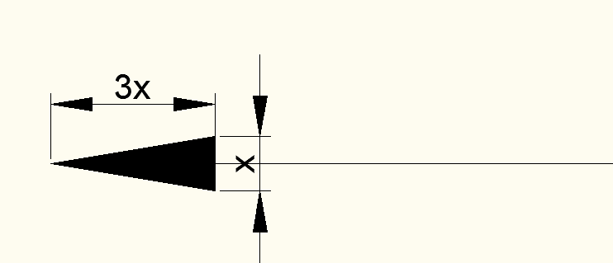

Slide 13
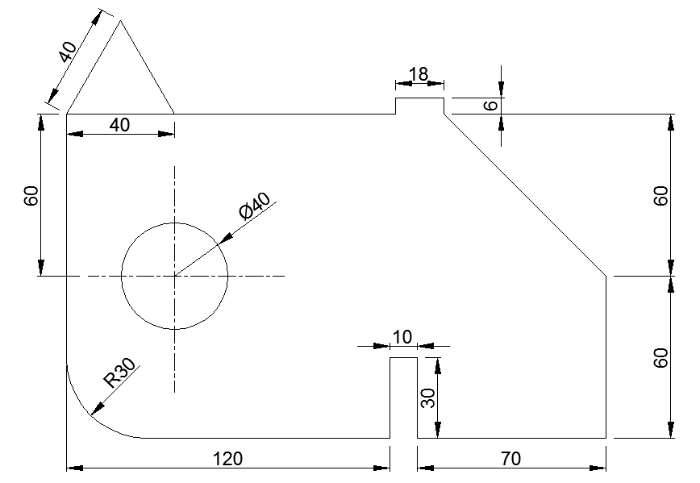

Slide 14
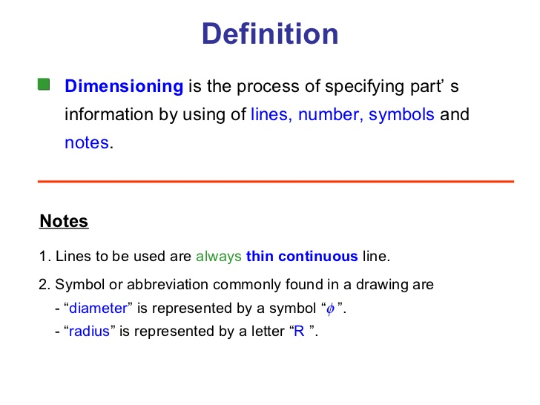

Slide 15
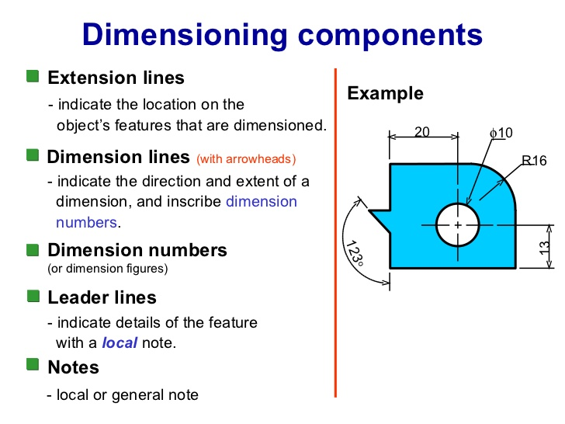

Slide 16
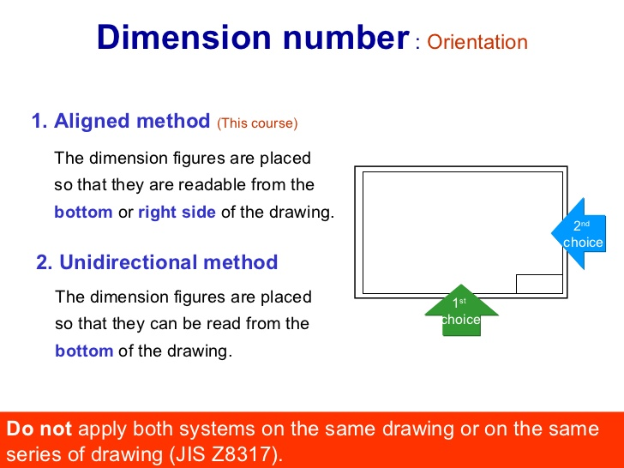

Slide 17
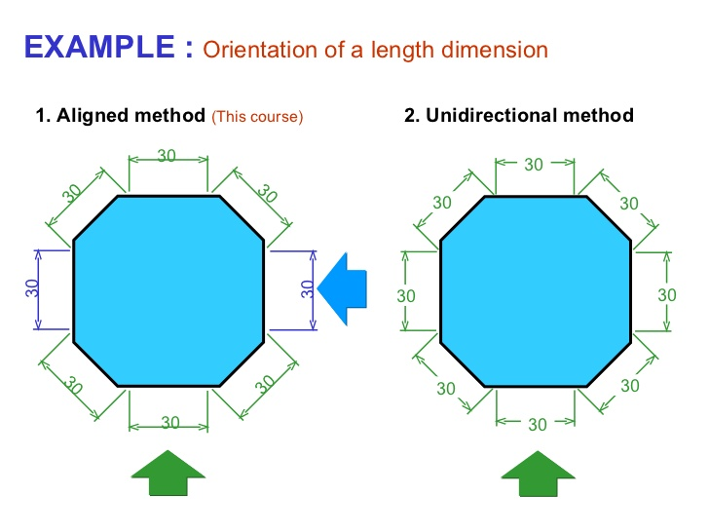

Slide 18
Title Block
The title block of a drawing, usually located on the bottom or lower right hand corner, contains all the information necessary to identify the drawing and to verify its validity. A title block is divided into several areas. The drawing title and the drawing number are used for identification and filing purposes.

Slide 19
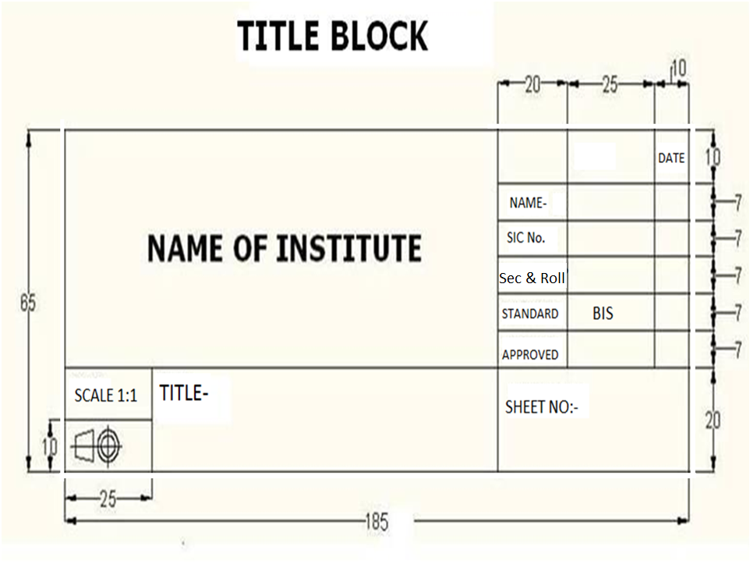

Slide 20
Standard Code
Country
Code
Full name
Turkey
TS
Turkish Standard
USA
ANSI
American National Standard Institute
Japan
JIS
Japanese Industrial Standard
UK
BS
British Standard
Australia
AS
Australian Standard
Germany
DIN
Deutsches Institut für Normung
ISO
International Standards Organization

Slide 21
Drawing Scales
Designation of a scale consists of the word “SCALE”
followed by the indication of its ratio, as follow
SCALE 1:1 for full size
SCALE X:1 for enlargement scales (X > 1)
SCALE 1:X for reduction scales (X > 1)
Dimension numbers shown in the drawing are correspond
to “true size” of the object and they are independent of
the scale used in creating that drawing.

Slide 22
List of Drawing Titles
Sheet Layout and Sketching with Dimensions.
Projection of Points, Straight Lines & Arc.
Projection of Planes.
Projection of Solids & Section view.
Isometric projection, Conics and Engineering Curves.
6. Development and Intersection of Surfaces.

Slide 23
Types of Projection
Orthographic projection
Isometric projection

Slide 24
Quadrants

Slide 25
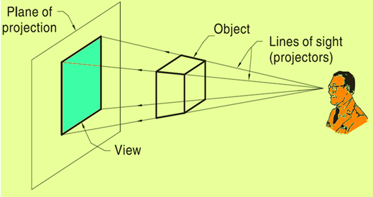
Projection
The act of obtaining the image of an object is termed “projection”.
All projection theory are based on two variables:
-Line of sight
-Plane of projection.

Slide 26
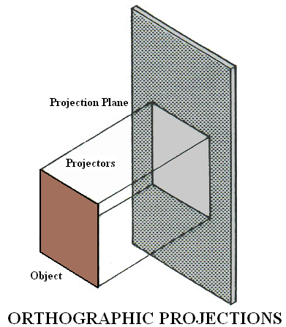
Orthographic Projections
When the projectors are parallel to each other and also perpendicular to the plane, the projection is called Orthographic projection.

Slide 27
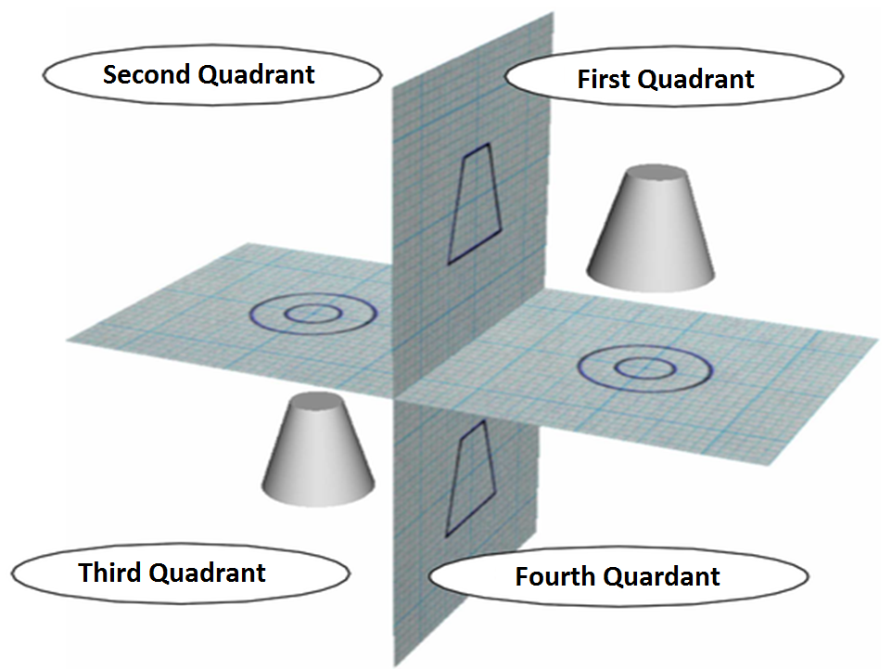

Slide 28
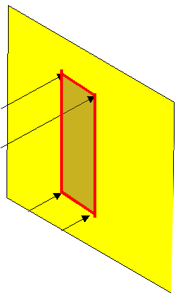
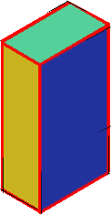
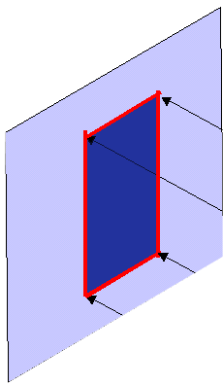
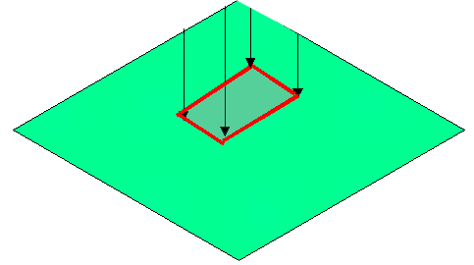
FIRST ANGLE
PROJECTION
FOR T.V.
IN THIS METHOD,
THE OBJECT IS ASSUMED TO BE
SITUATED IN FIRST QUADRANT
MEANS
ABOVE HP & INFRONT OF VP.
V.P.
P.P.
F.V.
S.V.
OBJECT IS INBETWEEN
OBSERVER & PLANE.
OBJECT
VP
PP
FV
LSV
X
Y
FOR S.V.
FOR F.V.
TV
HP
ACTUAL PATTERN OF
PLANES & VIEWS
IN
FIRST ANGLE METHOD
OF PROJECTIONS

Slide 29
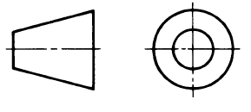
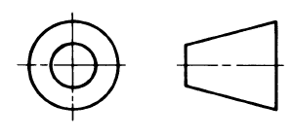
How do I know which method is being used?
Each method has its own symbol and they are as follows
First angle projection
Third angle projection

Slide 30
Projection of Points & Straight Lines

Slide 31
INTRODUCTION ABOUT POINT
Point has simply position but no magnitude.
Generally represented by a very small circle or a dot.

Slide 32
POSITION OF POINT
In orthographic projections space is divided into four quadrants.
By two reference plane: H.P and V.P
Point may be situated in any one of these quadrants.
It may also be on any one of the reference planes.

Slide 33
Basic concepts for drawing projection of point
FV & TV of a point always lie in the same vertical line
FV of a point P is represented by p’. It shows position of the point with respect to HP.
If the point lies below the HP, p’ lies below the XY line.
If the point lies in the HP, p’ lies on the XY line.
If the point lies above HP, p’ lies above the XY line.
TV of a point P is represented by p. It shows position of the point with respect to VP.
If the point lies in front of VP, p lies below the XY line.
If the point lies in the VP, p lies on the XY line.
If the point lies behind the VP, p lies above the XY line.

Slide 34
POINT A IN
2ND QUADRANT
VP
POINT A IN
1ST QUADRANT
VP
a’
A
A
a’
a
HP
OBSERVER
HP
OBSERVER
a
a
HP
HP
OBSERVER
OBSERVER
a
a’
A
a’
POINT A IN
3RD QUADRANT
A
POINT A IN
4TH QUADRANT
VP
VP

Slide 35
PROJECTIONS OF A POINT IN FIRST QUADRANT.
POINT A, ABOVE HP
& INFRONT OF VP
For TV
PICTORIAL
PRESENTATION
a’
A
Y
For Fv
a’
X
a
VP
X
Y
HP
a
Fv above xy,
TV below xy
.

Slide 36
PROJECTIONS OF A POINT IN FIRST QUADRANT.
POINT A, ABOVE HP
& INFRONT OF VP
POINT A, ABOVE HP
& ON VP
POINT A, ON HP
& INFRONT OF VP
For TV
For TV
PICTORIAL
PRESENTATION
PICTORIAL
PRESENTATION
For TV
a’
a’
A
A
For Fv
Y
Y
Y
For Fv
a
a’
X
a
a
X
X
A
For Fv
ORTHOGRAPHIC PRESENTATIONS
OF ALL ABOVE CASES.
Fv above xy,
TV below xy.
Fv above xy,
Tv on xy.
Fv on xy,
TV below xy.
VP
VP
VP
a’
a’
X
Y
X
Y
X
a’
Y
a
a
a
HP
HP
HP

Slide 37
CLASS-4 Projection of Lines

Slide 38
PROJECTIONS OF STRAIGHT LINES.
A straight line is the shortest distance between two points.
POSITIONS OF THE STRAIGHT LINE
A VERTICAL LINE ( LINE PERPENDICULAR TO HP & PARALLEL TO VP)
LINE PARALLEL TO BOTH HP & VP.
LINE INCLINED TO HP & PARALLEL TO VP.
LINE INCLINED TO VP & PARALLEL TO HP.
LINE INCLINED TO BOTH HP & VP.

Slide 39
Steps required for Drawing
Object parallel to a plane
When an line is parallel to a plane , true shape and dimensions will be projected on that plane.

Slide 40
For TV
Orthographic Pattern
(Pictorial Presentation)
V.P.
a’
Note:
FV is a vertical line
Showing True Length
&
TV is a point.
a’
1.
V.P.
A
Fv
FV
A Line
perpendicular
to HP
&
// to VP
b’
b’
Y
X
Y
B
For Fv
TV
a b
X
TV
a b
H.P.
Orthographic Pattern
(Pictorial Presentation)
Note:
FV & TV both are
// to xy
&
both show T. L.
V.P.
For TV
2.
a’
Fv
b’
V.P.
b’
A Line
// to HP
&
// to VP
F.V.
B
a’
A
Y
X
Y
For Fv
b
a
b
TV
X
T.V.
a
H.P.

Slide 41
Object inclined to a plane
When an line is inclined to a plane , apparent shape and dimensions will be projected on that plane.

Slide 42
Fv inclined to xy
Tv parallel to xy.
V.P.
3.
V.P.
b’
b’
A Line inclined to Hp
and
parallel to Vp
(Pictorial presentation)
B
F.V.
F.V.
a’
θ
θ
Y
X
Y
a’
θ
A
b
a
T.V.
b
X
T.V.
a
H.P.
Orthographic Projections
Tv inclined to xy
Fv parallel to xy.
V.P.
4.
V.P.
Fv
A Line inclined to Vp
and
parallel to Hp
(Pictorial presentation)
F.V.
b’
a’
b’
a’
A
Ø
B
X
Y
a
Ø
a
Ø
b
Tv
T.V.
b
H.P.

Slide 43
Orthographic Projections
Means Fv & Tv of Line AB
are shown below,
with their apparent Inclinations
α & β
Note the procedure
When True Length is known,
How to locate FV & TV.
(Component a’b₂’ of TL is drawn
which is further rotated
to determine FV)
V.P.
V.P.
b’
b’
b₁’
FV
Fv
TL
a’
α
a’
θ
α
b₂’
X
Y
X
Y
b₁
a
β
a
Ø
β
TV
Tv
TL
H.P.
b
H.P.
b
b₂
Here TV (ab) is not // to XY line
Hence it’s corresponding FV
a’ b’ is not showing
True Length &
True Inclination with Hp.
Here a’b₁’ is component
of TL ab₁ gives length of FV.
Hence it is brought Up to
Locus of a’ and further rotated
to get point b’. a’ b’ will be Fv.
Similarly drawing component
of other TL(a’b₁‘) TV can be drawn.

Slide 44
GENERAL CASES OF THE LINE, IF IT IS INCLINED TO BOTH HP & VP
PROBLEM :-6
Line AB is 100 mm long and it is 30⁰ & 45⁰ Inclined to HP & VP respectively. End A is 15 mm above Hp and 20 mm in front of VP. Draw the projections. Line is in 1st quadrant.
b’
b’₁
100
30
a’
X
Y
a
45
1
100
b
b₁

Slide 45
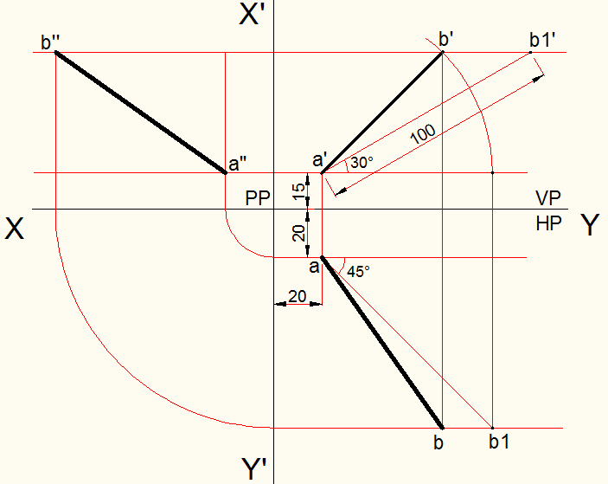

Slide 46
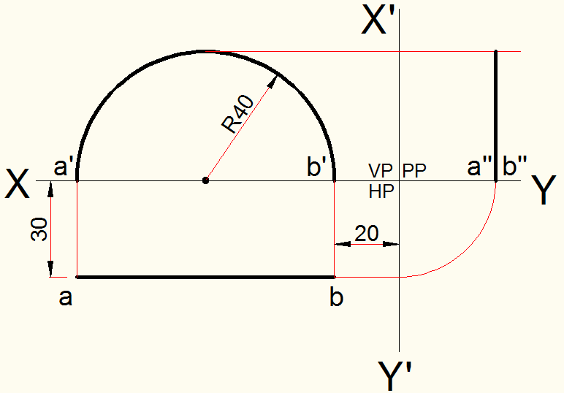
Problem-7. An 180⁰ arc (half circle) is parallel to VP and 30 away from it. End points A and B is on HP. Arc radius is 40mm and point B is 20 away from the Profile plane. Draw its F.V, T.V and Left side view.

Slide 47
CLASS-5 Projection of Planes

Slide 48
Projection of planes
A plane is a two-dimensional geometric entity. It has length and width but no thickness. Plane is pre-defined shapes.
Example-
Triangular Plane,
Square Plane,
Rectangular Plane,
Pentagonal Plane,
Hexagonal Plane,
Circular Plane
Semicircular Plane etc.

Slide 49
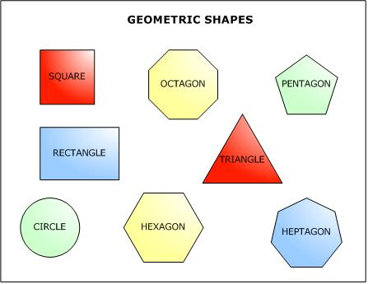

Slide 50
Steps required for Drawing
Object parallel to a plane
When an plane is parallel to a HP /VP , true shape and dimensions will be projected on that plane.
When an plane is inclined to a HP /VP , apparent shape and dimensions will be projected on the corresponding plane.

Slide 51

CASE OF A RECTANGLE – OBSERVE AND NOTE ALL STEPS.
SURFACE PARALLEL TO HP
PICTORIAL PRESENTATION
SURFACE INCLINED TO HP
PICTORIAL PRESENTATION
ONE SMALL SIDE INCLINED TO VP
PICTORIAL PRESENTATION
For T.V.
For Tv
For T.V.
FV-1
FV-2
FV-3
For Fv
For F.V.
For F.V.
T V-1
T V-2
T V-3
ORTHOGRAPHIC
TV-True Shape
FV- Line // to xy
ORTHOGRAPHIC
FV- Inclined to XY
TV- Reduced Shape
ORTHOGRAPHIC
FV- Apparent Shape
TV-Previous Shape
VP
VP
VP
d₁’
c₁’
a’
d’
b’
c’
a₁’
a’
d’
b₁’
b’
c’
a
d
a₁
d₁
a₁
d₁
b
c
b₁
c₁
b₁
c₁
HP
A
HP
B
C
HP

Slide 52
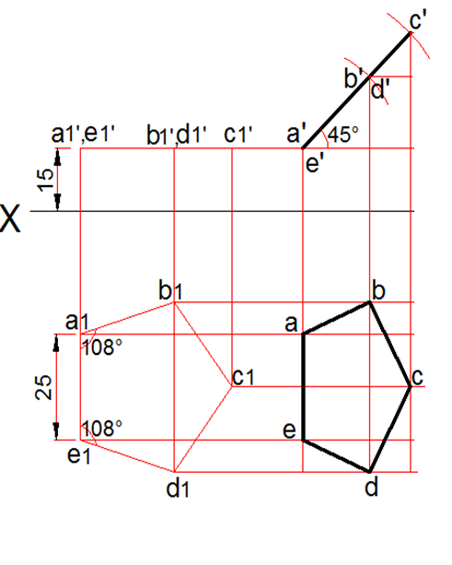
Draw all the views (F.V, T.V, LS.V) of a regular pentagon of side 25mm, with its surface making an angle 45⁰ with H.P. & perpendicular to V.P. One of the side of the pentagon is parallel to H.P and 15 away from it. Profile plane is 20mm from the nearest corner.

Slide 53
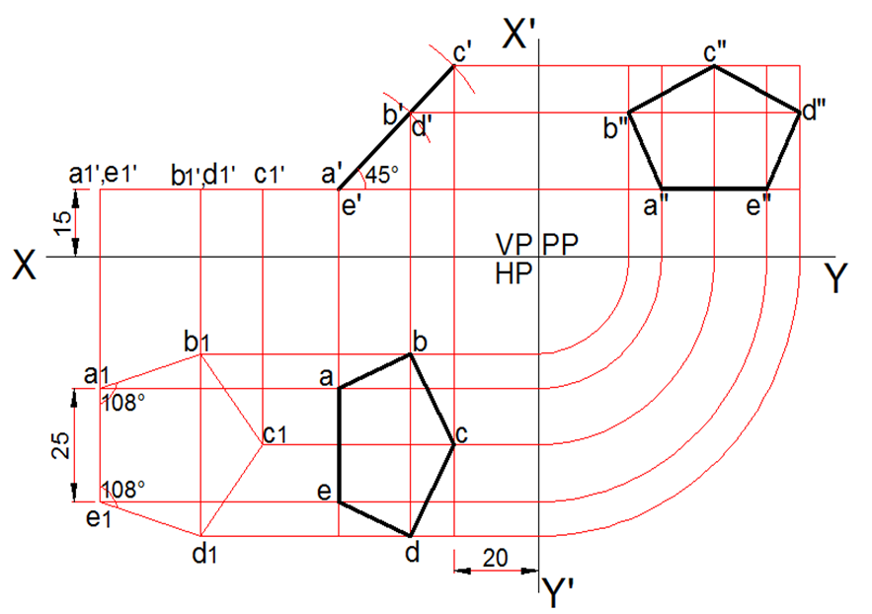

Slide 54
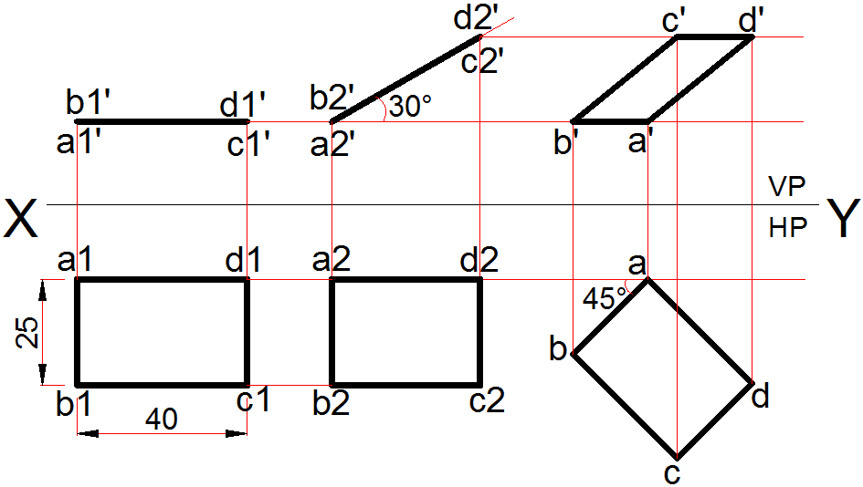
Problem-5. A rectangle ABCD of size 40 X 25 mm length is inclined 30⁰ to the HP. Its shorter side AB is parallel to HP and inclined at 45⁰ to VP. Draw the front view and top view of the rectangle.

Slide 55
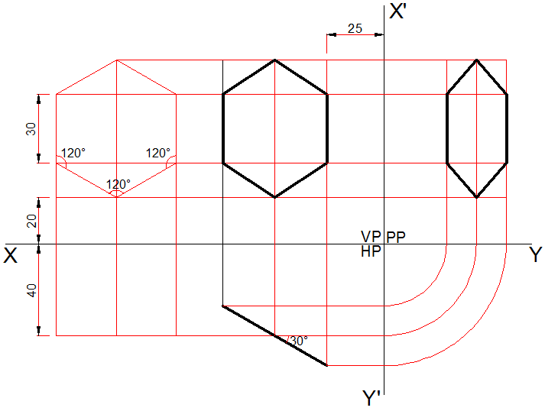
Q.6:- A regular hexagonal plane of 30mm side, has a corner at 40 from V.P and 20 from H.P. Its surface is inclined at 30⁰ to V.P and perpendicular to H.P. Profile plane is 25mm from the nearest side. Draw all the views (F.V, T.V, LS.V) of the plane.

Slide 56
CLASS-7 Projection of Solids

Slide 57
Projection of solids
Any object having definite length, width and height is called as a solid. In engineering drawing, solids are often represented by two or more orthographic view. i.e., FV, TV and SV.

Slide 58
SOLIDS
To understand and remember various solids in this subject properly,
those are classified & arranged in to two major groups.
Group A
Solids having top and base of same shape
Group B
Solids having base of some shape
and just a point as a top, called apex.
Cylinder
Cone
Prisms
Pyramids
Triangular Square Pentagonal Hexagonal
Triangular Square Pentagonal Hexagonal
Cube
Tetrahedron
( A solid having
six square faces)
( A solid having
Four triangular faces)

Slide 59
SOLIDS
Dimensional parameters of different solids.
Square Prism
Square Pyramid
Cylinder
Cone
Apex
Apex
Top
Rectangular
Face
Slant
Edge
Triangular
Face
Longer
Edge
Base
Base
Base
Base
Corner of base
Edge
of
Base
Edge
of
Base
Corner of base
Generators
Imaginary lines
generating curved surface
of cylinder & cone.
Sections of solids( top & base not parallel)
Frustum of cone & pyramids.
( top & base parallel to each other)

Slide 60
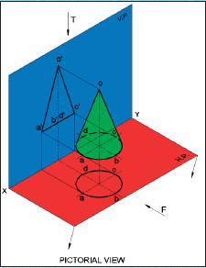
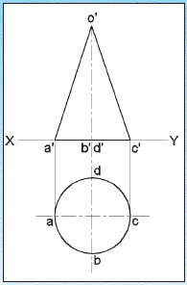
PROJECTION OF SOLIDS WHEN ITS AXIS PERPENDICULAR TO ONE REFERENCE PLANE AND PARALLEL TO THE OTHER
Case (1) Axis perpendicular to the H.P and Parallel to the V.P

Slide 61
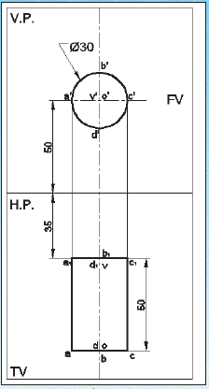
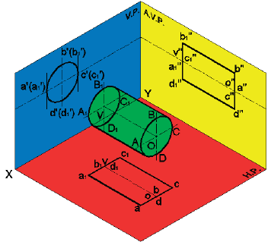
PROJECTION OF SOLIDS WHEN ITS AXIS PERPENDICULAR TO ONE REFERENCE PLANE AND PARALLEL TO THE OTHER
Case (2) Axis perpendicular to the V.P and Parallel to the H.P

Slide 62
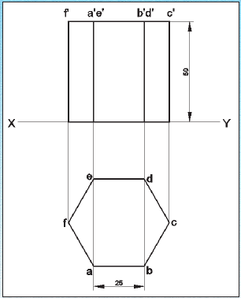
EXAMPLE:-
Project the front view and top view of a hexagonal prism of 25 mm base edges and 50 mm height, having two of its vertical rectangular faces parallel to V.P; and its base resting on H.P

Slide 63
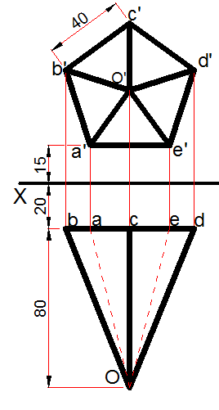
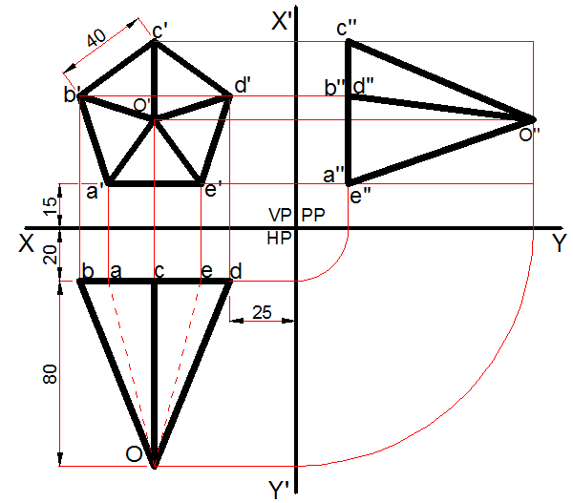
Problem-1.
A pentagonal pyramid of base 40 side and axis 80 long, having an edge of the base parallel to H.P & 15 away from it. Draw the projections of the pyramid (FV, TV & LS.V), when its axis is perpendicular to V.P and the base is 20 away from it. Here profile plane is 25mm from the pyramid.

Slide 64
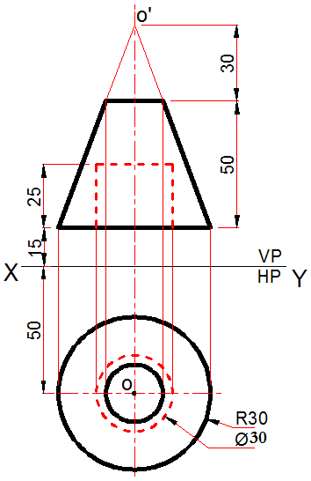
Problem-2.
Draw the projection of a frustum cone having base Radius 30 and axis height 80mm. The cone is cut by a section plane parallel to base and 30 away from Apex. Cone base is parallel to HP, 15 away form it & 20 away from VP. The frustum has a concentric hole from base of Dia 30 and 25mm height. Draw the front and top view of the frustum cone.

Slide 65
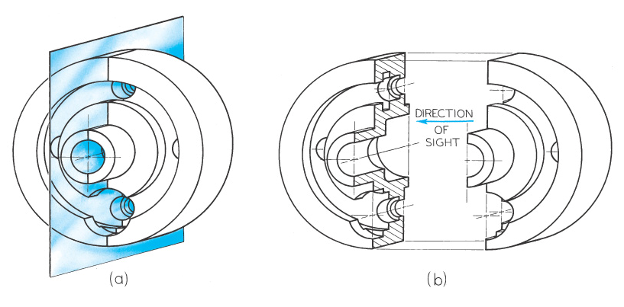
Section Views
To produce a section view a cutting plane is passed through the part (figure a).
The cutting plane is removed and the two halves are drawn apart (figure b) exposing the interior detail.

Slide 66
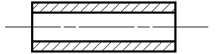
HATCHING
On sectional views, solid areas should be hatched to indicate that they are solid. Hatching is drawn with a thin continuous line, equally spaced (preferably about 4mm apart, though never less than 1mm) and preferably at an angle of 45º.
When you are hatching an object but the objects has areas that are separated, all areas of the object should be hatched in the same direction and with the same spacing.

Slide 67
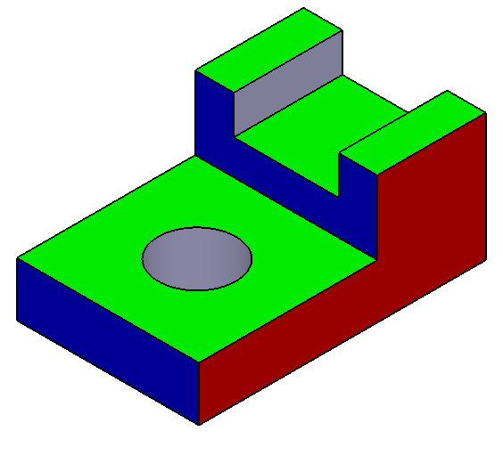

Problem-4.
Draw the F.V, T.V of the given object, and make the full section view from the Right side.

Slide 68
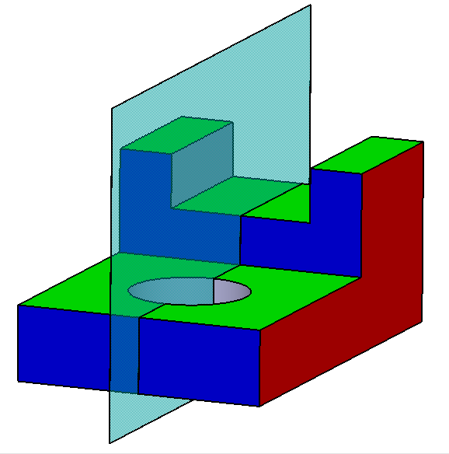

Slide 69
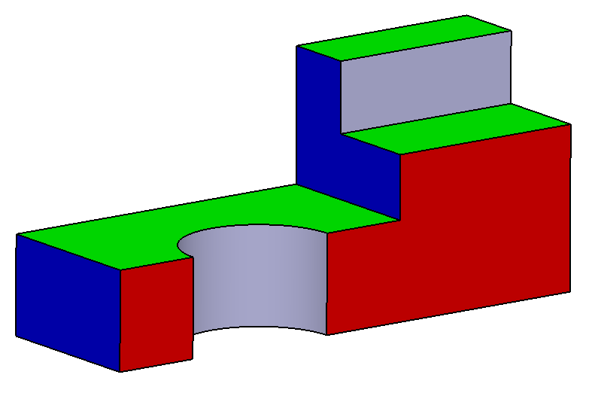

Slide 70
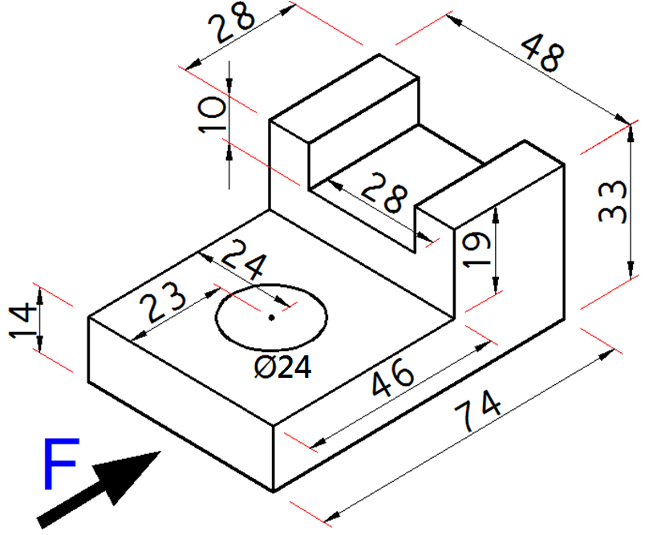

Slide 71
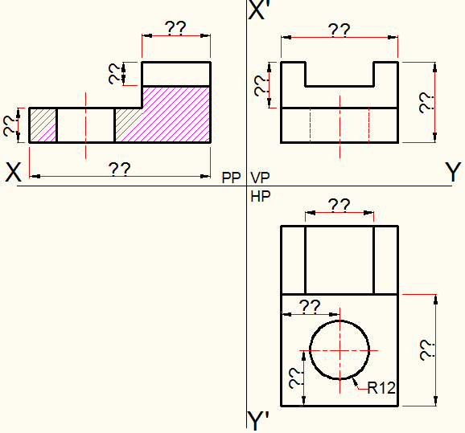

Slide 72
CLASS-9 Isometric projection

Slide 73
What Is ISOMETRIC ?
It is a method of producing pictorial view of an object showing all three faces of the object simultaneously.
It is also a type of parallel projection.

Slide 74
Isometric Drawing
Isometric drawing is a drawing drawn on an isometric axes using full scale.
Isometric drawings are almost always preferred over isometric projection for engineering drawings, because they are easier to produce
Isometric projection
(True projection)
Isometric drawing
(Full scale)
Forshorten
Full scale

Slide 75
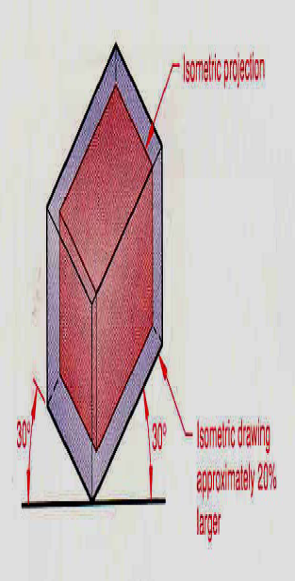
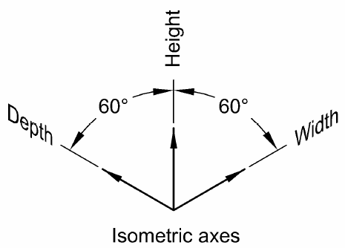
Isometric Axes
An isometric drawing is an axonometric pictorial drawing for which the angle between each axis equals 120 degrees and the scale used is full scale

Slide 76
SHAPE
Isometric view if the Shape is
F.V. or T.V.
1
H
D
RECTANGLE
D
A
D
A
L
L
C
D
C
A
B
C
B
B
B
H
TRIANGLE
3
B
1
B
1
L
3
L
A
D
A
3
1
2
A
2
2
4
PENTAGON
H
E
1
E
4
1
D
4
E
D
A
D
A
D
L
L
1
3
3
A
C
C
2
B
3
B
B
C
2
2

Slide 77
ISOMETRIC
OF
PLANE FIGURES
SHAPE
IF F.V.
IF T.V.
2
HEXAGON
AS THESE ALL ARE
2-D FIGURES
WE REQUIRE ONLY TWO ISOMETRIC AXES.
IF THE FIGURE IS FRONT VIEW, H & L AXES ARE REQUIRED.
IF THE FIGURE IS TOP VIEW, D & L AXES ARE REQUIRED.
CIRCLE
For Isometric of Circle/Semicircle use Rhombus method. Construct Rhombus
of sides equal to Diameter of circle always. ( Ref. topic ENGG. CURVES.)
SEMI CIRCLE
For Isometric of
Circle/Semicircle
use Rhombus method.
Construct it of sides equal
to diameter of circle always.
( Ref. Previous two pages.)

Slide 78
Z
3
STUDY
ILLUSTRATIONS
DRAW ISOMETRIC VIEW OF A
CIRCLE IF IT IS A TV OR FV.
FIRST ENCLOSE IT IN A SQUARE.
IT’S ISOMETRIC IS A RHOMBUS WITH
D & L AXES FOR TOP VIEW.
THEN USE H & L AXES FOR ISOMETRIC
WHEN IT IS FRONT VIEW.
FOR CONSTRUCTION USE RHOMBUS
METHOD SHOWN HERE. STUDY IT.
A
B
2
2
4
A
B
3
4
D
3
C
1
D
C
1

Slide 79
Z
4
STUDY
ILLUSTRATIONS
25 R
DRAW ISOMETRIC VIEW OF THE FIGURE
SHOWN WITH DIMENTIONS (ON RIGHT SIDE)
CONSIDERING IT FIRST AS F.V. AND THEN T.V.
50 MM
IF FRONT VIEW
100 MM
IF TOP VIEW

Slide 80
Z
5
STUDY
ILLUSTRATIONS
ISOMETRIC VIEW OF PENTAGONAL PYRAMID STANDING ON H.P. (Height is added from center of pentagon)
ISOMETRIC VIEW OF BASE OF PENTAGONAL PYRAMID STANDING ON H.P.
4
4
D
D
E
E
D
L
D
L
1
3
1
3
A
C
B
A
C
2
B
2

Slide 81
Z
6
STUDY
ILLUSTRATIONS
ISOMETRIC VIEW OF
PENTAGONALL PRISM
LYING ON H.P.
4
H
E
1
D
A
L
3
C
2
B
ISOMETRIC VIEW OF
HEXAGONAL PRISM
STANDING ON H.P.

Slide 82
Z
7
STUDY
ILLUSTRATIONS
CYLINDER STANDING ON H.P.
CYLINDER LYING ON H.P.

Slide 83
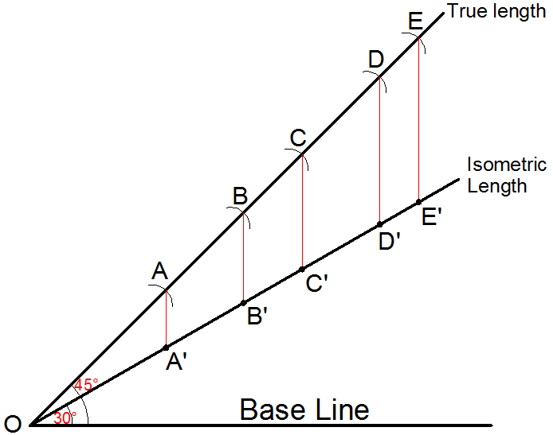

Slide 84
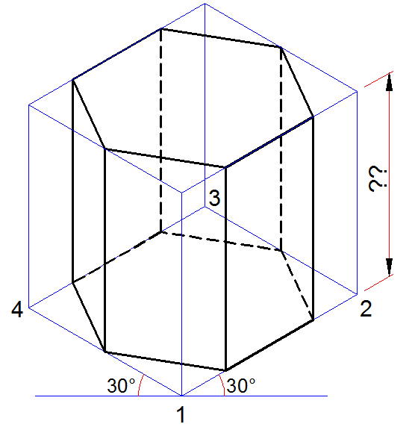

Slide 85


Slide 86
CLASS-11 Development of Surfaces

Slide 87
DEVELOPMENT OF SURFACES OF SOLIDS.
“The development of surface of an object means the unrolling and unfolding of all surfaces of the object on a plane.”
LATERLAL SURFACE IS THE SURFACE EXCLUDING SOLID’S TOP & BASE.
EXAMPLES:-
Boiler Shells & chimneys, Pressure Vessels, Trays, Boxes & Cartons, Large Pipe sections, Body & Parts of automotives, Ships, Aero planes and many more.

Slide 88


Important points.
It is a shape showing AREA, means it’s a 2-D plain drawing.
Hence all dimensions of it must be TRUE dimensions.
As it is representing shape of an un-folded sheet, no edges can remain hidden
And hence DOTTED LINES are never shown on development.
Everyday Examples

Slide 89

PROCESS OF UNFOLDING OF SURFACES OF A SOLIDS .

Slide 90


Slide 91




Slide 92



Slide 93



Slide 94



Slide 95
Development of lateral surfaces of different solids.
(Lateral surface is the surface excluding top & base)
Cylinder: A Rectangle
Pyramids: (No.of triangles)
Cone: (Sector of circle)
S
H
S
L
L
πD
D
H= Height D= base diameter
θ
Prisms: No.of Rectangles
R=Base circle radius.
L=Slant height.
L= Slant edge.
S = Edge of base
θ
=
R
+
L
360⁰
H
S
S
H= Height S = Edge of base
Cube: Six Squares.
Tetrahedron: Four Equilateral Triangles
All sides
equal in length

Slide 96
FRUSTUMS
DEVELOPMENT OF
FRUSTUM OF CONE
DEVELOPMENT OF
FRUSTUM OF SQUARE PYRAMID
Base side
Top side
L
L
L₁
L₁
θ
θ
=
R
+
L
360⁰
R= Base circle radius of cone
L= Slant height of cone
L₁ = Slant height of cut part.
L= Slant edge of pyramid
L₁ = Slant edge of cut part.

Slide 97

DEVELOPMENT OF PRISM
Problem:
A hexagonal prism of side of base 30 and axis 60 long, base is parallel to H.P, a rectangular face is parallel to V.P. Draw the full development of the prism.

Slide 98

A square pyramid, with side of base 40 and axis 70 long, is resting on its base on H.P, with an edge of the base parallel to V.P. It is cut by a section plane perpendicular to V.P and inclined at 45⁰ H.P. The section plane is passing through the mid-point of the axis, Draw the development of the surface of the cut pyramid.

Slide 99
Problem-3.
A cylinder diameter of base 30 and axis 60 long, is resting on its base on H.P. Cylinder is cut by a section plane perpendicular to V.P and inclined at 45⁰ to H.P. The section plane is passing through the top end of an extreme generator of the cylinder. Draw the Lateral surface development of cut cylinder.
Problem-4.
A vertical Cylinder of the base dia 70 is penetrated by a horizontal Cylinder of base dia 50 such that the axes of both intersect at the mid point. All the faces of both cylinders are equally inclined to V.P. Both cylinders are of equal length 100mm. Draw the projections of the two Cylinders, showing the lines intersection.

Slide 100


Slide 101
ENGINEERING CURVES

Slide 102


CONIC SECTIONS
ELLIPSE, PARABOLA AND HYPERBOLA ARE CALLED CONIC SECTIONS
BECAUSE
THESE CURVES APPEAR ON THE SURFACE OF A CONE
WHEN IT IS CUT BY SOME TYPICAL CUTTING PLANES.
OBSERVE
ILLUSTRATIONS
GIVEN BELOW..
Ellipse
Section Plane
Through Generators
Section Plane
Parallel to Axis.
Parabola
Hyperbola
Section Plane Parallel
to end generator.

Slide 103


Slide 104
Draw an Ellipse by concentric circle method. Take major axis 120 mm and minor axis 60 mm long.
ELLIPSE
3
2
4
C
1
3
5
2
4
1
5
A
B
10
6
10
9
7
6
8
D
9
7
8

Slide 105


Slide 106
CYCLOID:-
Cycloid is a locus of a point on the circumference of a rolling circle(generator), which rolls without slipping or sliding along a fixed straight line or a directing line or a director.
Rolling Circle or Generator
P
R
C
C
P
P
Directing Line or Director

Slide 107
PROBLEM 22: DRAW LOCUS OF A POINT ON THE PERIPHERY OF A CIRCLE WHICH ROLLS ON A STRAIGHT LINE PATH. Take Circle diameter as 70 mm
CYCLOID
4
p₄
3
5
p₃
p₅
C
p₂
p₆
C₁ C₂ C₃ C₄ C₅ C₆ C₇ C₈
2
6
p₁
1
7
p₇
P
p₈
πD

